Slide 2














Slide 3





























Slide 4


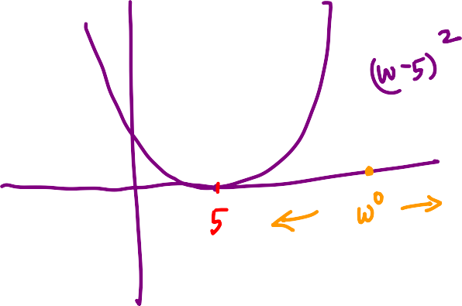
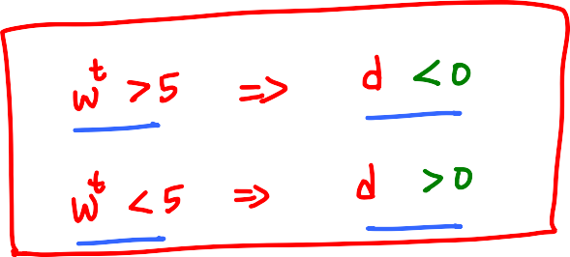















Slide 5








Slide 6
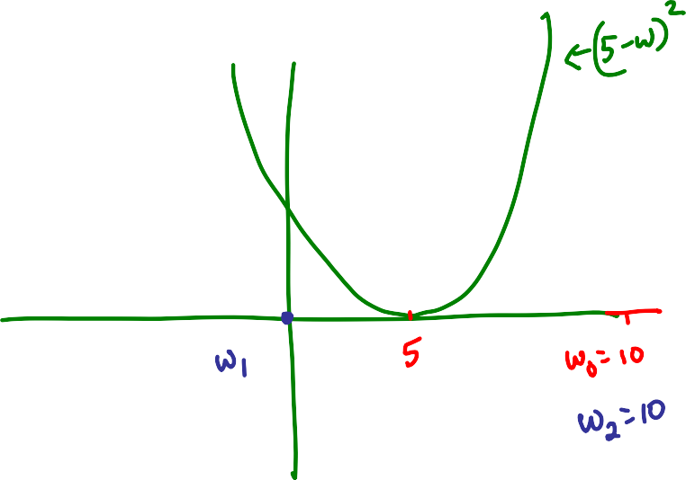












Slide 7







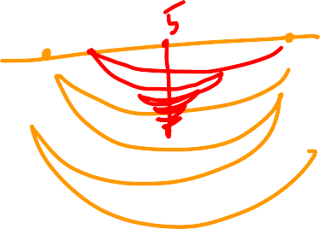















Slide 8








Reaches only a finite distance from w₀

Slide 9






















Slide 10
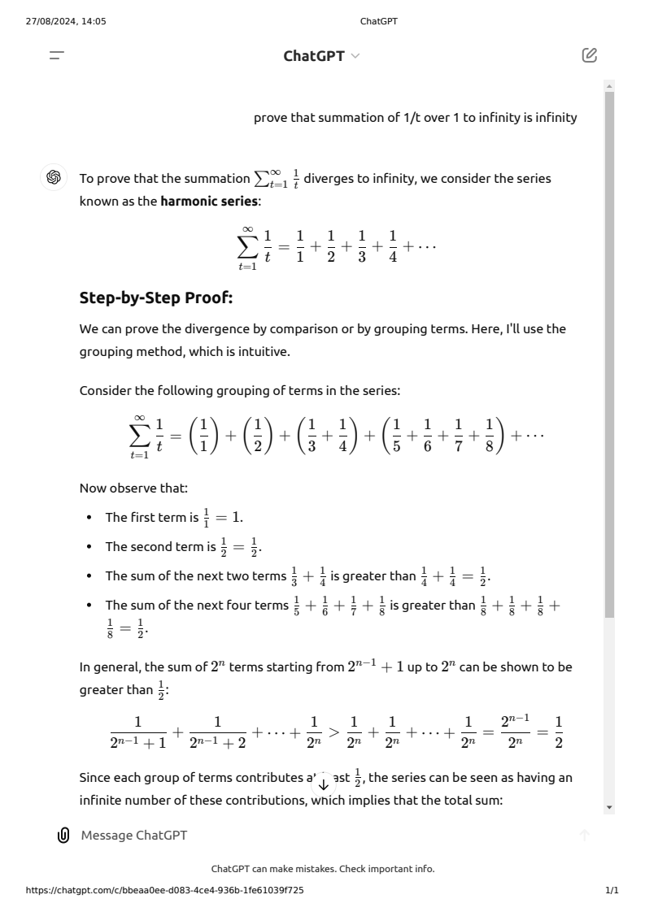

Slide 11
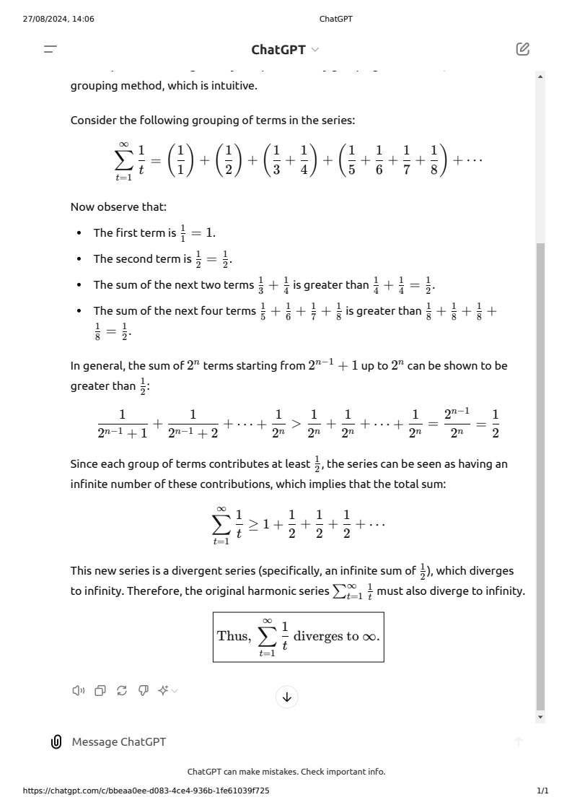

Slide 12
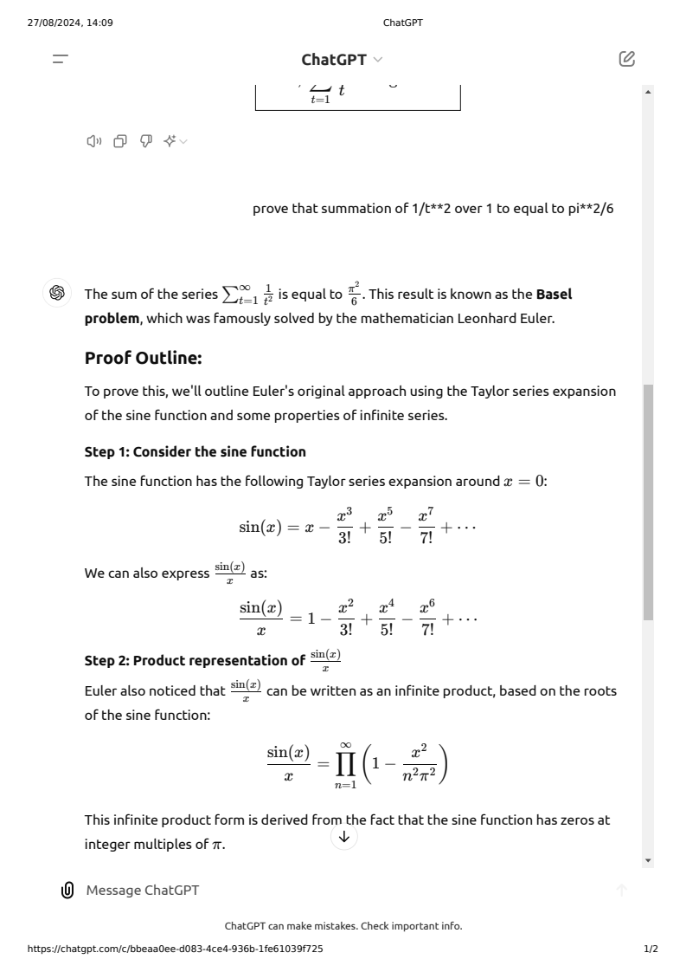

Slide 13
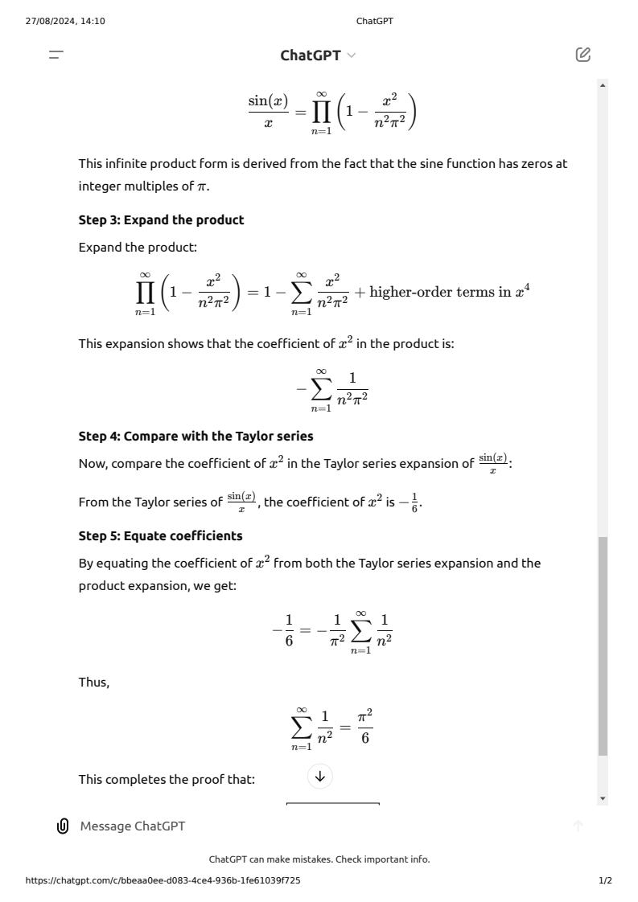

Slide 14


























Slide 15




















Slide 16








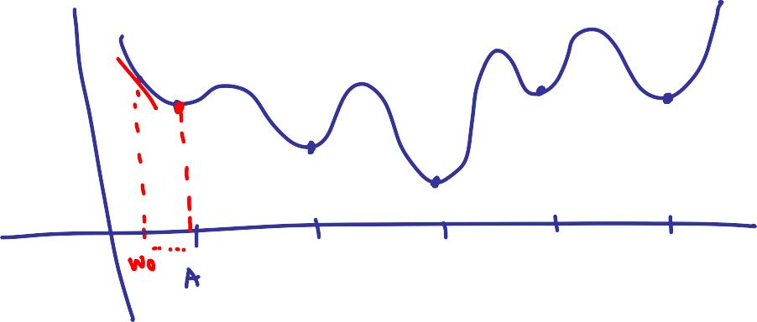

Slide 17




Slide 18














Slide 19












Slide 20



















Slide 21








Is this a valid configuration
at optimality?
∇f(w*)
∇g(w*)
There is a descent
direction which
is also feasible!
∇g(w*)^{T}d <=0
∇f(w*)^{T}d <=0
The claim
is bogus

Slide 22























Slide 23




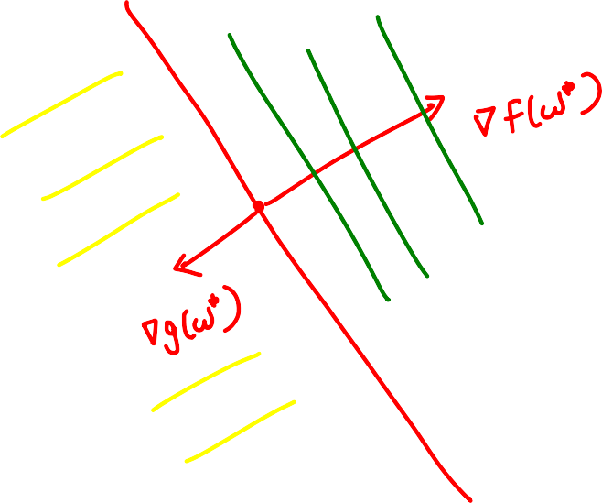




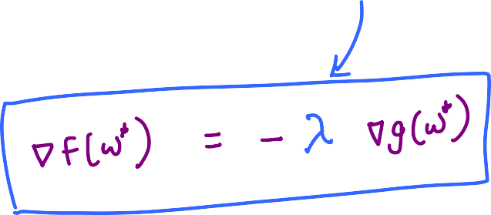











Slide 24

















Slide 25
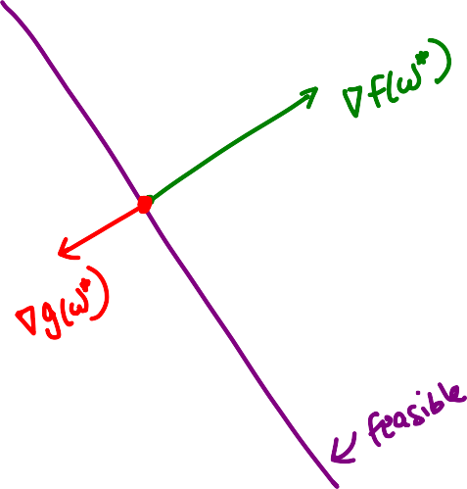






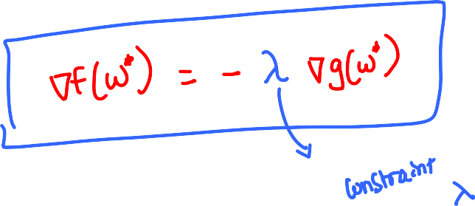






Slide 26











Slide 27













Slide 28












Slide 29








Slide 30















Slide 31




























Slide 32

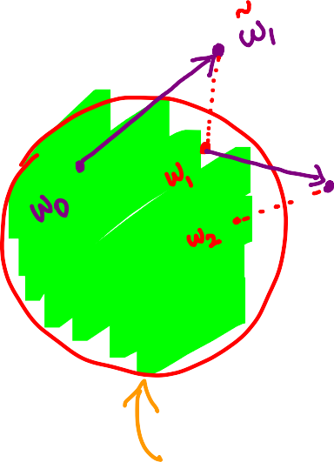
















Slide 33











